Slide 1
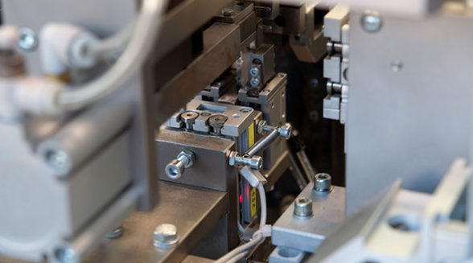


The 1st Fully Automated
Cable to Connector Assembly Lines
Company Introduction, Restart IL March 2025

Slide 2
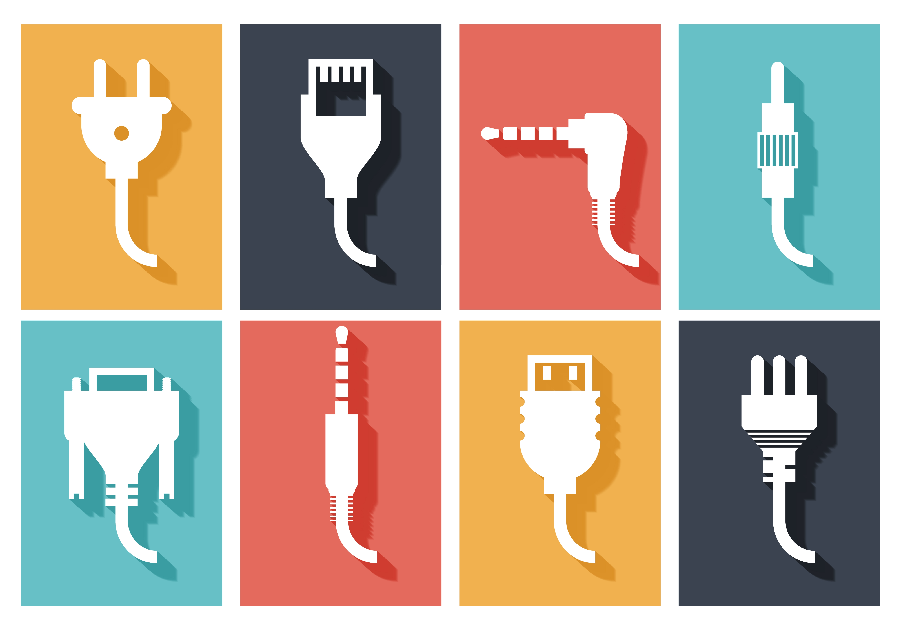
CABLES
are everywhere around us!
Computers, TV’s Cell phones, Audio systems...

Slide 3
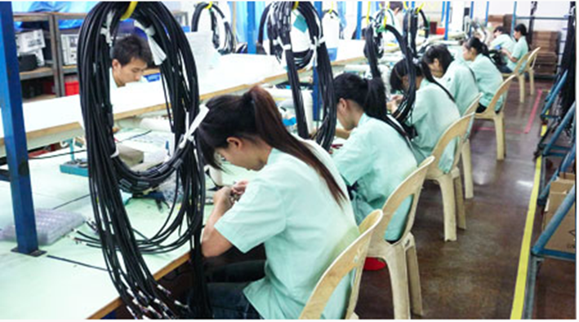
Cable to connector assembly
CABLES
B$60 <
<16%
Market Value
Communication & data cable assembly
Annual Growth
ALL cables are assembled
manually!

Slide 4

Inventory
No workers!
Supply chain
Quality
Pains
Workforce retention
Increasing costs

Slide 5
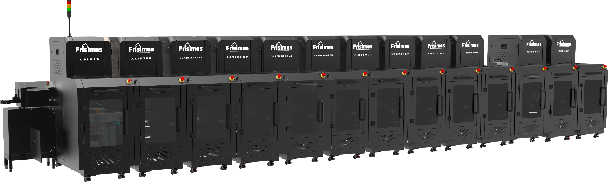
THE SOLUTION!
Fully automated cable to connector assembly lines
Line = 30+ workers

Slide 6




Patents – 8
Lasers, micro-robots
Team ~20
Sale & Service Agents
Germany, USA, Italy, Poland, Israel
Company
Profile
Investors
European Union’s EIT Manufacturing, Kibbutz Yotvata, Kvutzat Yavne & the Israeli Innovation Authority

Slide 7




Customers Type
Cable & Connector Mfr.
Increase product portfolio of higher value
Cable Assembly Firms
Provide final products to customers
OEMs
Cables are an integral part of their equipment
German customers

Slide 8

Achieve market leadership
Raising
Use of Funds
$8M - $10M (at SAFE or equity)
  Working Capital
  Increase production capacity
  Marketing & sales
  Post-sales services
  Develop Fiber Optics & USB-C lines
Current round &
Funds main uses

Slide 9
Thank you for your attention
Tal Pechter
CEO
tal@frisimos.com

