Slide 1

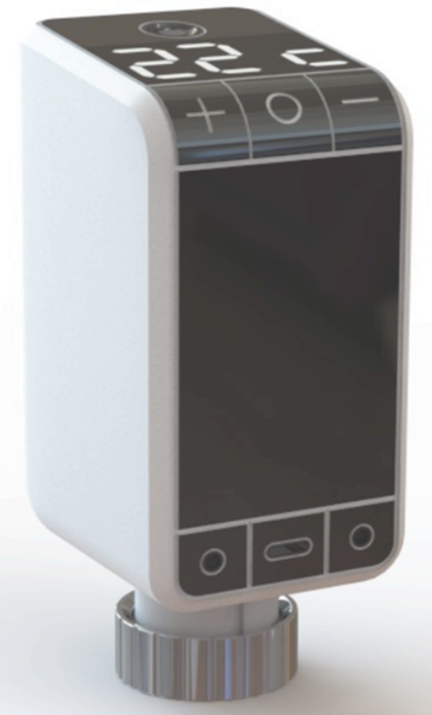
Powering
IoT Sustainably
March 2025

Slide 2







The need
The world is going digital
Digitalization, remote sensing, and activation require IoT
IoT requires power and communication
We supply continuous power and communication for IoT mass deployment

Slide 3

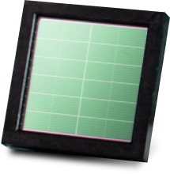
Ever lasting IoT Battery
Solar panel on a chip
High-efficiency charging circuit
Does not need direct sunlight
Operates in low light levels including greenhouse and indoor environments
Can mount directly onto PCB
Delivers 24/7/365 everlasting energy
Provides power bursts to operate valves

Slide 4




Zero-Energy IoT Heating Management
Autonomous Smart Thermostats
Central management & local room user control
Online monitoring of inbuilt climate
Add-on device. Light Self-powered. Effortless savings.
Real-time billing management

Slide 5
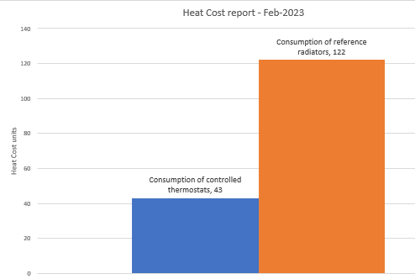
Benefits
Huge energy savings (~35%)
Online monitoring of inbuilt climate
Online monitoring of infrastructure status
Central property control along room user control
Machine learning & AI algorithm
Real-time billing management
Improves Stranded Assets Investment Grade

Slide 6

Product Launch
Strategic partner:
Milestones:
  PoC test, Winter 2022-2023
Commercial Test, Winter 2023-2024
                Major Commercial Order & agreement for additional mass deployment negotiated, 2025 / Combined HW & long-term SaaS Model

Slide 7
Thank you
teddy@sol-chip.com
sol-chip.com

