Slide 1
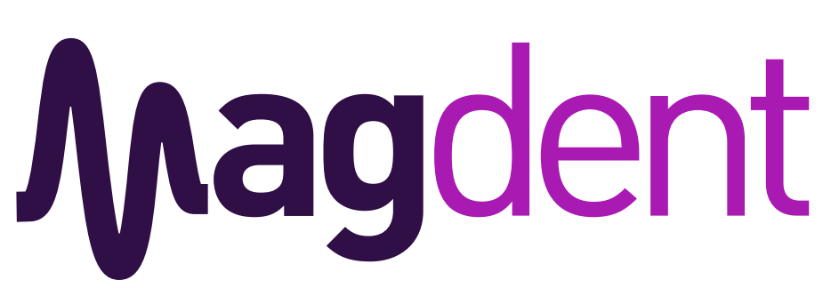
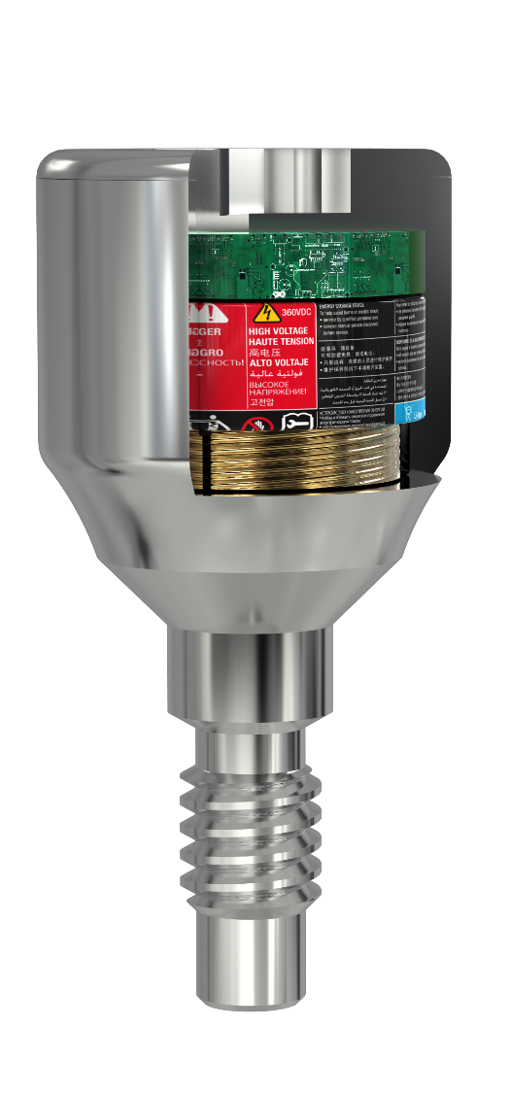


  Electromagnetic healing.
  OPTIMIZING IMPLANTOLOGY
Revolutionizing dental implantology with proven PEMF technology
Benny Barak, CEO
benny@magdentmed.com
+972 524 329 329

Slide 2
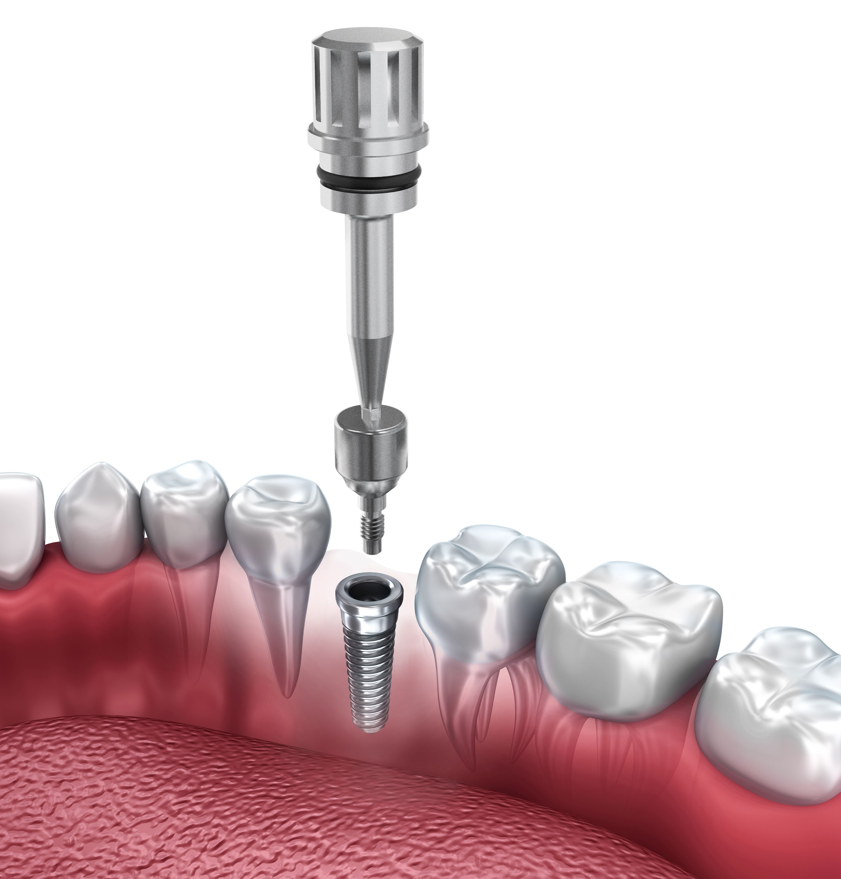
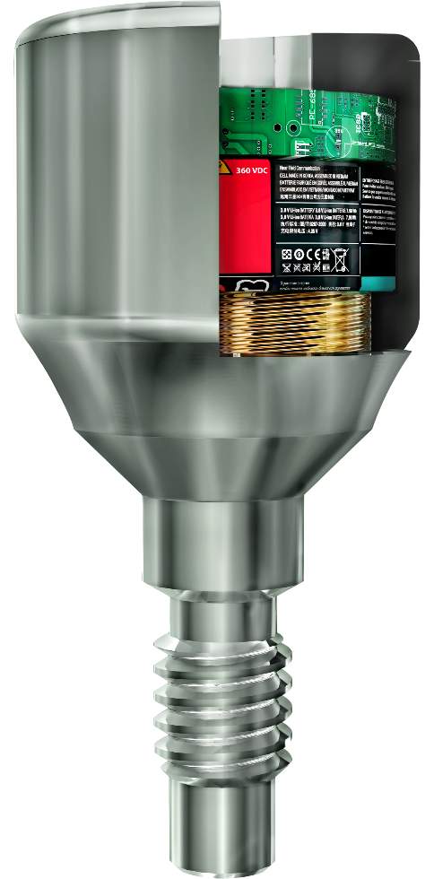


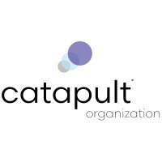
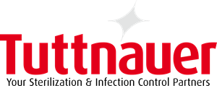



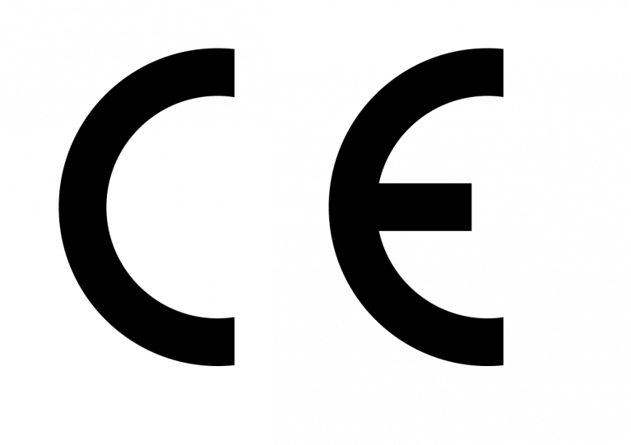

WHY MAGDENT IS A UNIQUE INVESTMENT OPPORTUNITY
First Mover Advantage, using FDA approved technology – 1st time in dentistry
Raised $7M to date
Raising $8M – A Round
CE clearance
FDA in process – 510K De Novo
Market expansion – 28,000 Units ordered
Seasoned C-level Entrepreneurs - 4th dental & Orthopedic start ups – 1 went IPO (NASDAQ: PYPD)

Slide 3

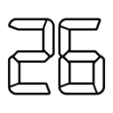
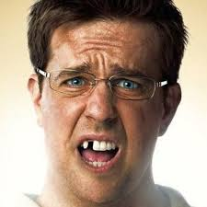
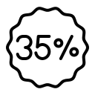

Why now? Higher demand for oral health
% of adults over 35 have lost at least one tooth.
% of adults over 74 have lost all their teeth
of implant patients develop BONE LOSS
1.4 Bn
The global population over 60 by 2030
Million people with implants
The Hangover
Total Available Market
9.6$ B
Serviceable Available Market
7.5 $ B
Serviceable Obtainable Market
  4.8 $ B
Notes:
TAM: (30M implants x $49=)$855M + (19M x 80% x $100=)$1.520M + (19M x 30% x $100 x1.5=)$855M = $3.23B
SAM: $9.6B x 75% = $7.5B
SOM: $9.6B X 80% X 80% = $4.8B

Slide 4
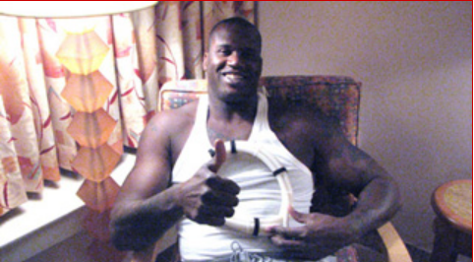
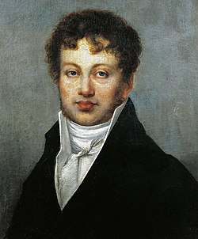

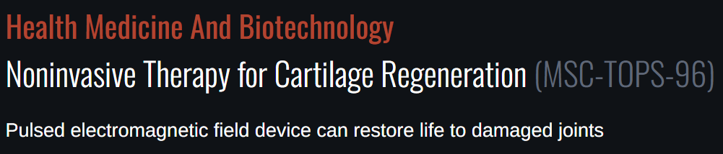

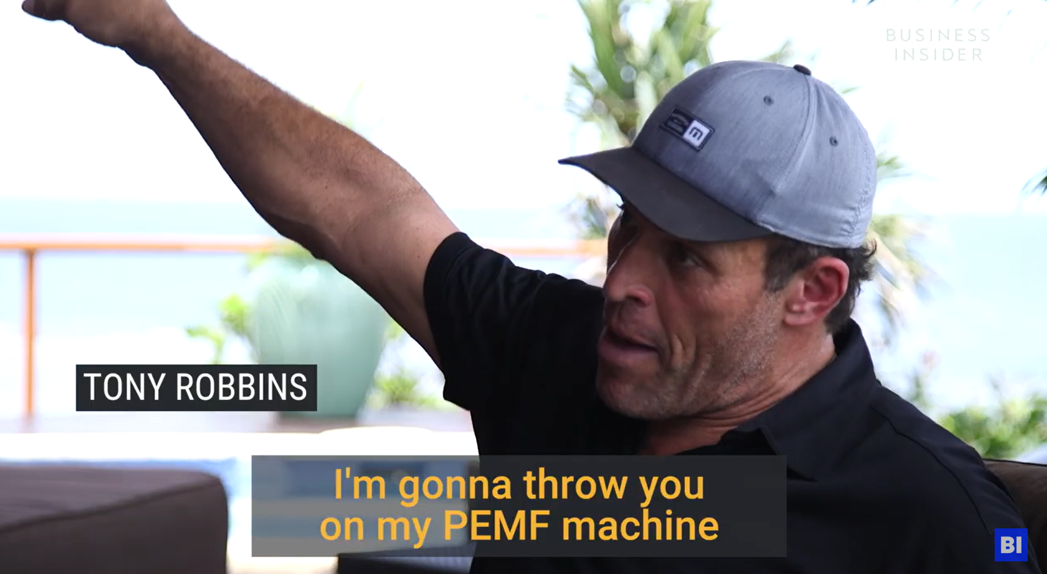
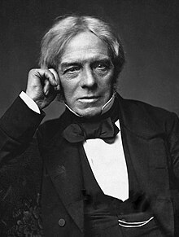
What is Pulsed Electromagnetic Field
Pulsed Electromagnetic Field (PEMF) is a technology that uses short pulses of electromagnetic energy to stimulate and accelerate biological healing processes at the cellular level.
André-Marie Ampère 1823
NASA – Late 1960s
Shaquille O'Neal, NBA Allstar
https://drcliff.com/friends.html
Michael Faraday 1831
https://technology.nasa.gov/patent/MSC-TOPS-96
https://www.businessinsider.com/tony-robbins-daily-routine-therapy-electric-taco-pmf-pulsed-electromagnetic-field-machine-fiji-2017-10

Slide 5

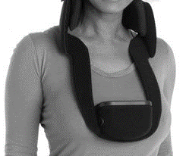


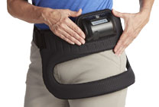

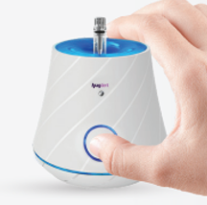
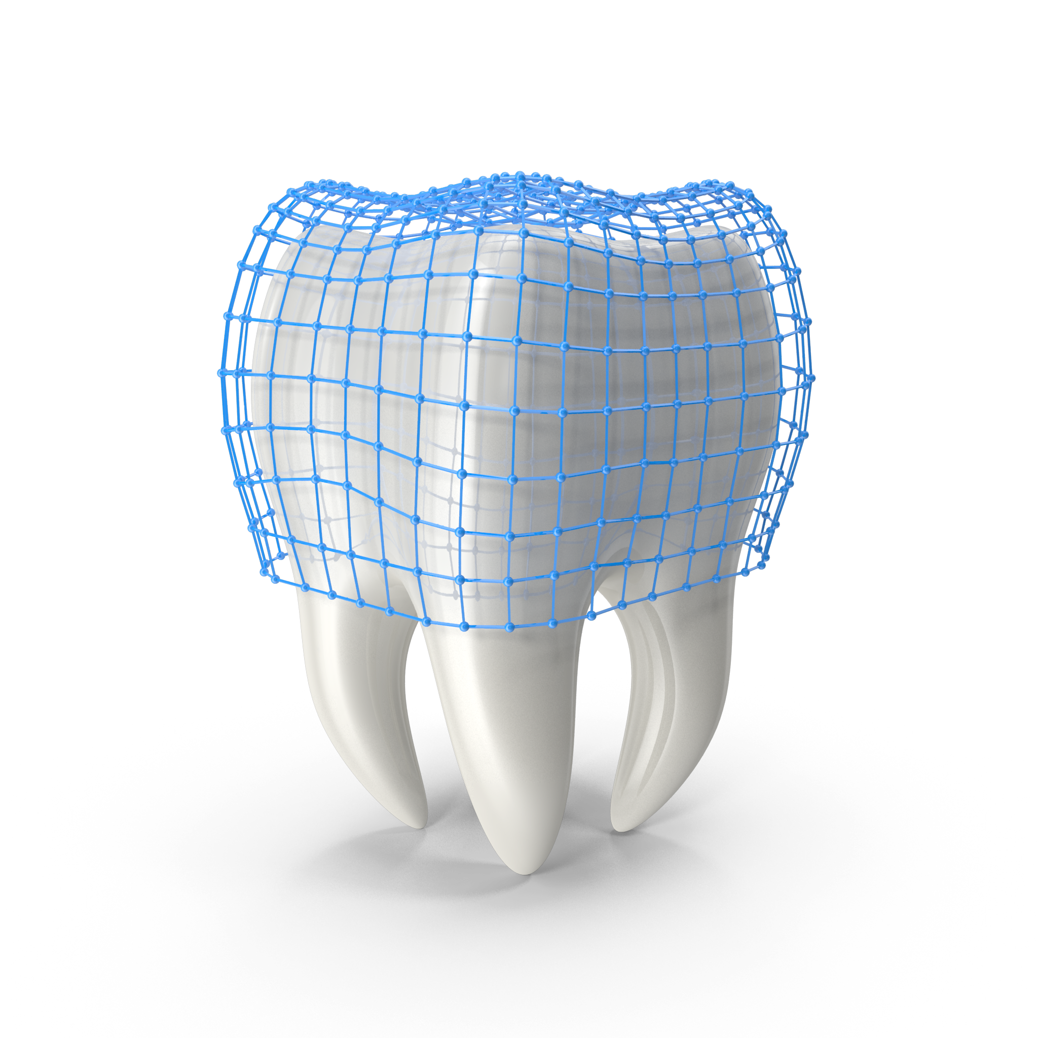
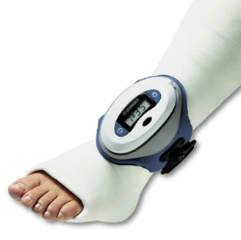
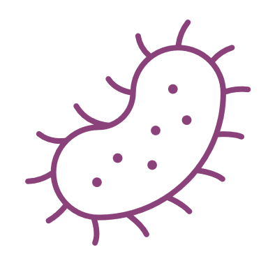
A New Standard of Care in One Treatment
Magdent introduced a proven technology for the 1st time in dentistry - Pulsed ElectroMagnetic Field (PEMF)
The Problems
The technology
Magdent Dental Solution
Miniaturized
Electromagnetic Healing Abutment
The main challenges in Dental Implantology
A Long Healing Period
3-6 months
PEMF is FDA Approved since 1979
Failure with High-Risk Patients
(Diabetes, Aging population, Osteoporosis, heavy smokers)
Bone Loss
(Peri-implantitis)

Slide 6
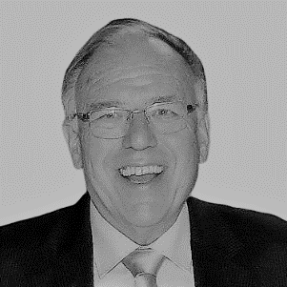
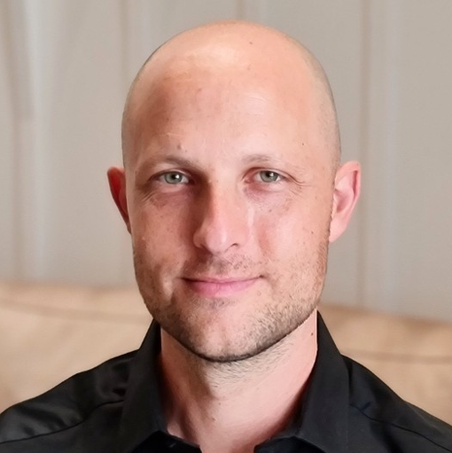
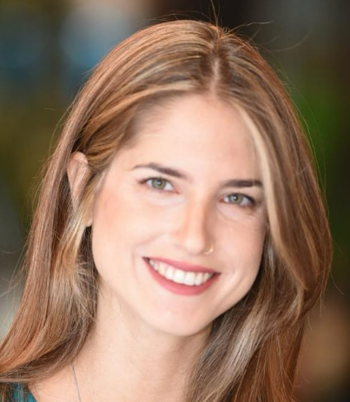
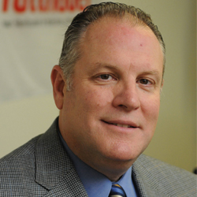
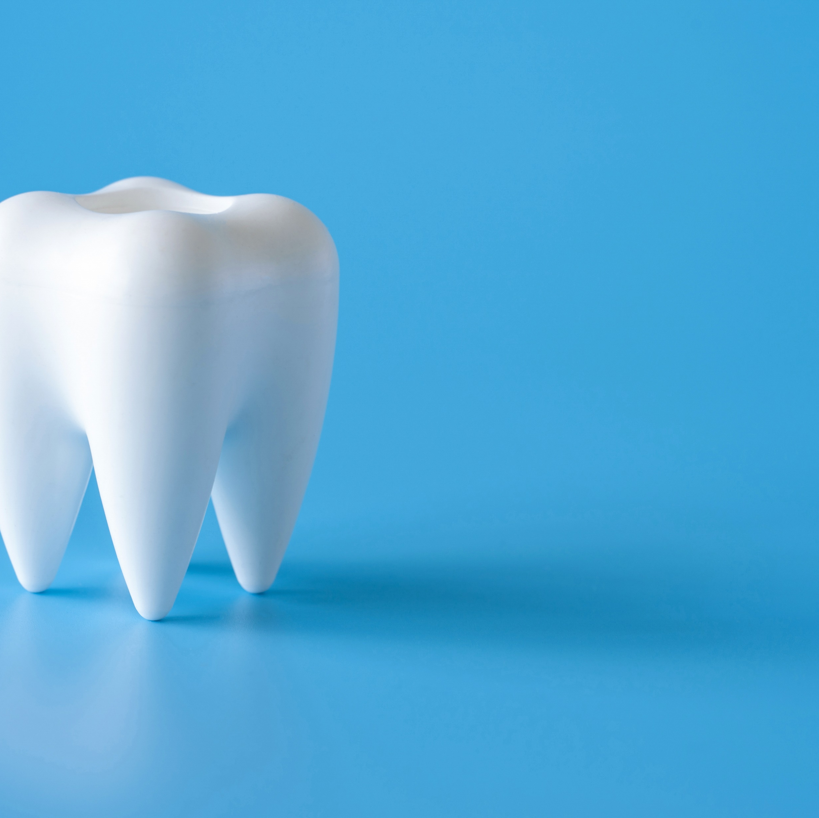
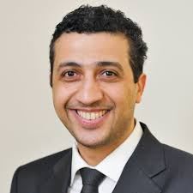
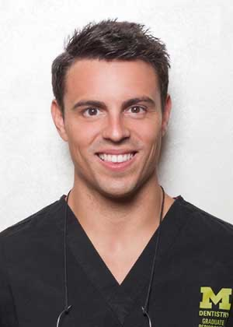
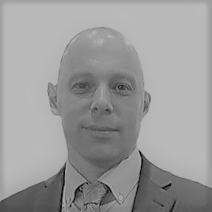
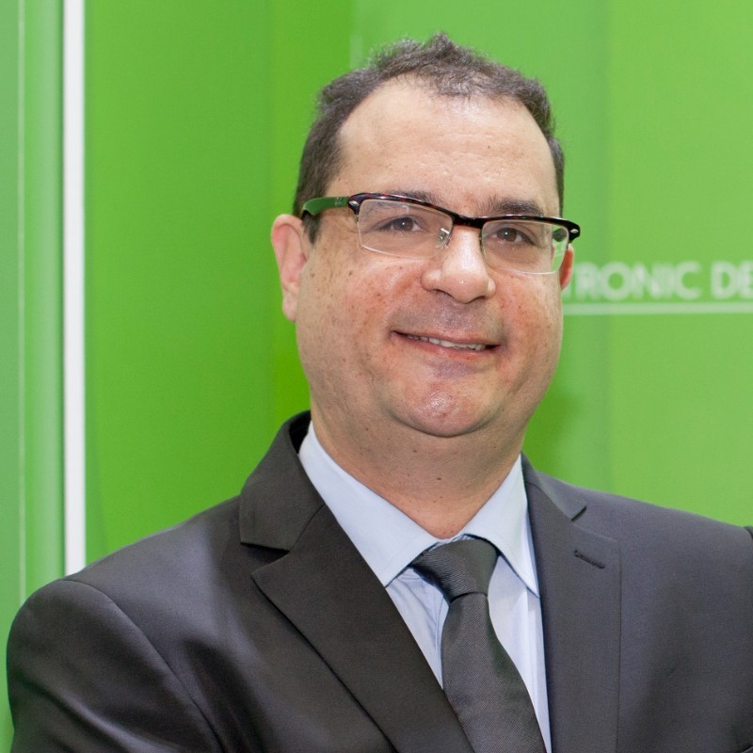
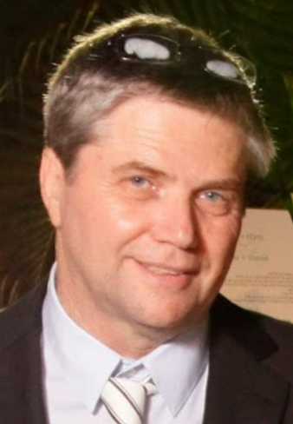
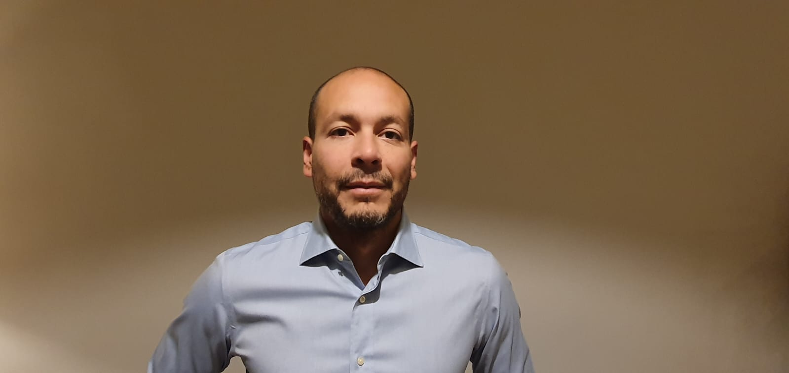
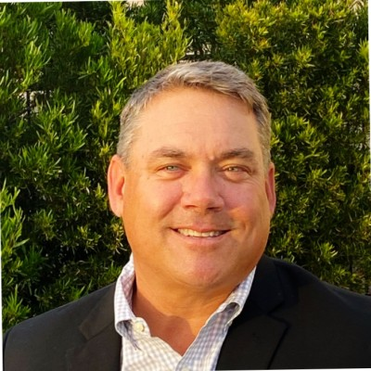
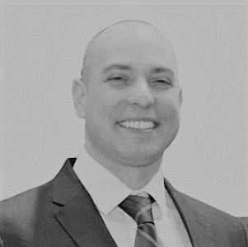
Meet The Team
Serial Entrepreneurs in Dental and Medtech
Tier-one KOLs in the Dental industry
Managing global companies in Medtech
Advisory board
Prof. Jamil Shibli PhD
Vice Dean of Dental Research, University of Guarulhos. Reviewer of the journals: International Journal of Oral and Maxillofacial Implants, COIR, Journal of Clinical Periodontology, Journal of Periodontology and Clinical Implant Dentistry.
Prof. Shlomo Barak
D.M.D
Founder &
Chairman of the Board
Oral & Maxillofacial surgeon. Serial entrepreneur
Adv. Benny Barak
LLB., M.B.A
Chief Executive Officer
14 years of int. business
experience, Ex-Accenture
Elinor Zohar
Director of R&D
8 Years in Medical Device R&D
Ran Tuttnauer
Board Member
Serial Entrepreneur in medical device, Angel investor
Dr. Alberto Monje, DDS
A world leader in Peri implantitis research with over 100 publications, Head in Periodontics, CICOM, Badajoz, Adjunct Professor, UIC, Barcelona, Adjunct Professor, UM, Ann Arbor Visiting Faculty, ZMK, Bern
Michael Keeter
Ex-Nobel BioCare - Director of Training & Education of North America, 30 years of experience in the dental and medical sales industry
Dr. Oleg Dolkart
PhD Medical Sc.
Chief Medical Officer
25 years as lead researcher
Dr. Moshe Neuman, DMD
Founder & Technology Director, Periodontist, diplomate of the American Board of Periodontology
Arie Schlein
Engineer
Director of Manufacturing
20 Years in medical and engineering positions
Armando Carciente
MBA
Director of Business Development
15 years of experience in medical and dental senior positions

Slide 7

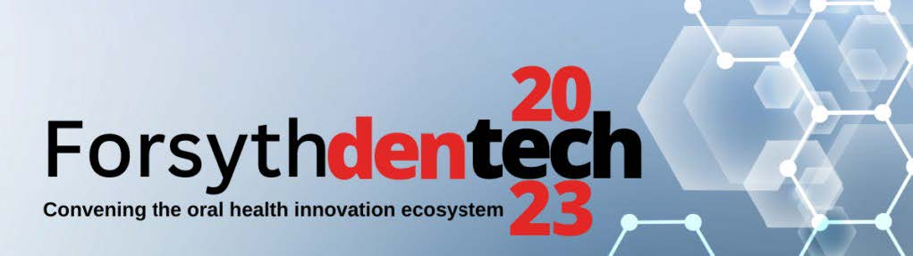

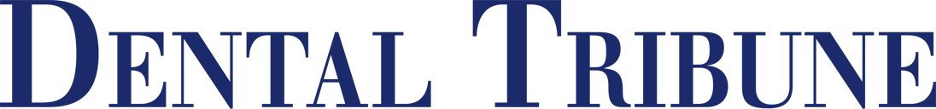
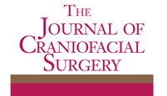


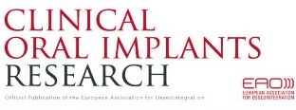


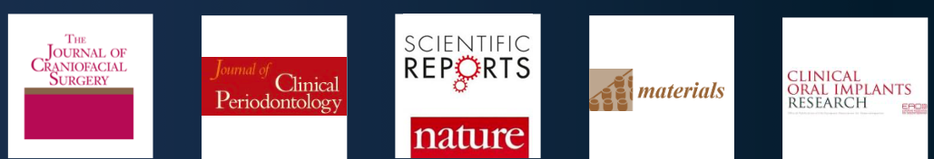
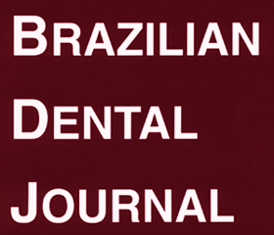
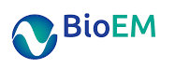
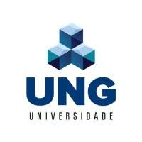
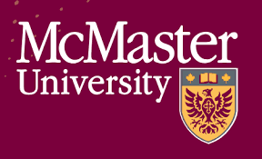




Value Proposition + Proven Results
Magdent accelerates healing and prevent complications, ensuring implants success.
Miniaturized electromagnetic device abutment improves stability of the dental implants
A new device for improving dental implants anchorage
Antimicrobial effects of a pulsed electromagnetic field
Bone Regeneration Revolution – PEMF Modulates Macrophage Derived Exosomes to Attenuate Osteoclastogenesis
Microbiome Modulation of Implant-Related Infection by a Novel Miniaturized Pulsed Electromagnetic Field Device
More
More
More
More
More
Stay Tuned:
Long-term peri implantitis treatment, Peri implant Mocusitis treatment,
Bone Grafting recovery with PEMF,
etc.
Pulsed electromagnetic fields increase osteogenetic commitment of MSCs
A novel nonsurgical therapy for peri-implantitis using focused pulsed electromagnetic field
Effect of the Pulsed Electromagnetic Field (PEMF) on Dental Implants Stability
Pulsed Electromagnetic Therapy: Literature Review and Current Update
More
More
More
More
https://magdentmed.com/clinical-research/
Lead Academic Partners

Slide 8

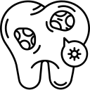

Optimizing Implants Procedures, Preventing Complications
Use Magdent during implant placement or later to address implant complications
Implant Placement
Peri implant Mucositis
Peri implantitis
X3
Faster Bone Formation
Increasing Patients pool –
Poor bone quality
Preventing
implant failures
Treating
Bone Loss
Accelerating healing,
Reducing treatment for 1-2 months
Osteoporosis, diabetes, heavy smokers, Cancer patients.
Controlling Bacteria Biofilm Colonization.
Enhancement & thickening
of Soft Tissue
Growing bone in inflammatory conditions

Slide 9
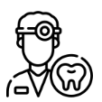



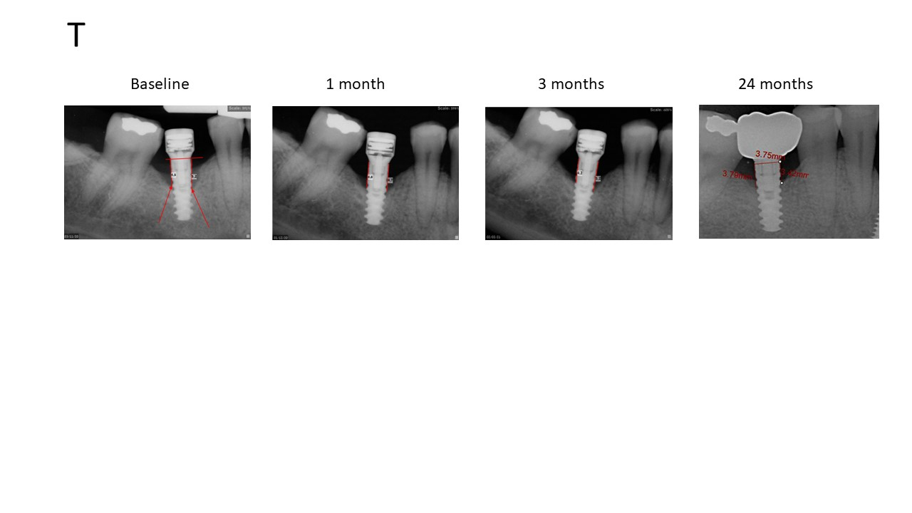
Benefits for all dental players
Dentists / DSO
Patients
Dental Implant Companies
Insurance
Companies
Up to $0.5M per year
Savings of thousands of $
Millions of Dollars
Millions of Dollars
Increase Patients Pool
Less complications
Savings on R&D
Reducing Payments
Increase Revenues –
$200 per treatment + Available chair time
Minimum Additional Cost
Door Opener for additional products
ROI & Minimal Investment
Faster Treatment
Increasing Market Share
Notes:
A compelling offer for dentists to increase their income for the same medical procedure.

Slide 10

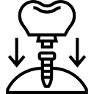
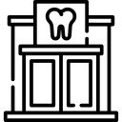



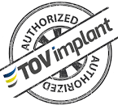



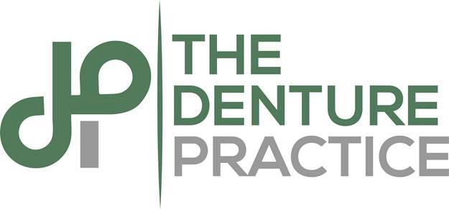









Distributions & GTM – Growth Stage
Currently serve 50 implants models
Dental Implants Companies
Dental Clinic Chains
Russia
UK
France
Netherlands
Germany
Poland
USA*
Portugal
Italy
Spain
China
South Korea
Israel
India *
Hong Kong
Mexico *
Singapore
Available in multiple
countries
Chile
Australia
New Zealand
Clearance
Available in U.S in 2027 – 510K DeNovo
*

Slide 11







Investment Round Numbers
Join our investors
Raised since inception
Raising – Round A
$7 M
$8 M
$128.9
Million
28,000 MEDs ordered in signed Distribution Agreements
$75.53
Million
Use of Funds - Scale Up & FDA
$36.32
Million
2025
Prevention Studies completion
FDA Studies (Clinical, Animal, BioC)
Growth in target markets (with CE)
$2.16
Million
2026
FDA Studies (Clinical)
$30
Thousands
Growth in target markets (with CE)
FDA Approval
2024
2025
2026
2027
2028
2027
Market Growth (USA, EU, ROW)
European
Expansion
European
Expansion
Growth
Growth
FDA
Clearance
Growth

Slide 12




Opportunities
Join our growth revolution – Round A
Distribution Partners
Live Demo
Magdent’s booth today / IDS in Cologne until this Saturday
Benny@magdentmed.com
Notes:
A compelling offer for dentists to increase their income for the same medical procedure.

Slide 13


Benny Barak, CEO
benny@magdentmed.com
+972 524 329 329
Notes:
הנעה לפעולה:
חדשנות פורצת דרך וכד'

Slide 14













Growing Market due to higher demand for oral health
Increase of dental diseases
Cosmetic Dentistry
Dental Tourism
1.4 Bn People over 60 years in 2030, compared to 900M in 2015
Total Available Market
Serviceable Available Market
Serviceable Obtainable Market
TAM
SAM
SOM
Million people with implants
30M implants
80% Peri-implant Mucositis
32% Peri-Implantitis
13.9M implants in the EU and USA which consist 75% of the global market +
China
+
India
4M Implants per year
80% of implants are placed in posterior teeth which are suitable for use of healing abutments
The MED can be compatible to 80% of implant brands and models
Of household’s medical spending is for dental across OECD
More annual dental spending for patients over 65
Increase in per capital dental expense compared to GDP Growth
9.6$ B
7.5 $ B
  4.8 $ B
Notes:
TAM: (30M implants x $49=)$855M + (19M x 80% x $100=)$1.520M + (19M x 30% x $100 x1.5=)$855M = $3.23B
SAM: $9.6B x 75% = $7.5B
SOM: $9.6B X 80% X 80% = $4.8B

